Slide 1
Double Trouble
Experimental Pattern Detector
By: Etienne Brown, Donya Ahmadi, James Davidson

Slide 2
TABLE OF CONTENTS
01
02
03
UNDERSTANDING THE PROBLEM
OUR PROCESS & MODELS
CONCLUSIONS (FINAL MODEL)
How can we optimize active stock market trading?
Establish patterns, write targets, train and test models.

Slide 3
Understanding the Problem
01

Slide 4
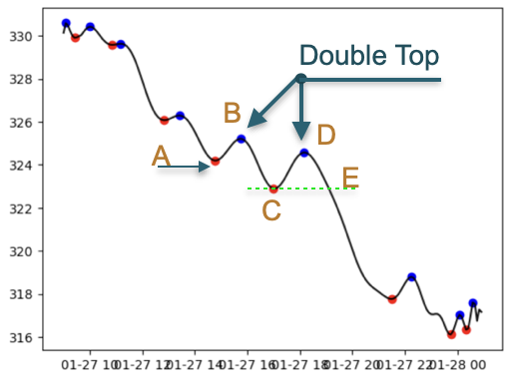
UNDERSTANDING THE PROBLEM
Background
Double top/bottom are technical reversal patterns that form after an asset reaches a high/low price two consecutive times with a moderate decline/incline between the two high/lows.
Our goal is to establish a trading algorithm to identify these patterns. The end user would utilize entry signals based on predictive machine learning models, eliminating emotional doubts and strengthening trade conviction.

Slide 5
Our Process
02

Slide 6
OUR PROCESS
Why this pattern?
Champion Model
78%
Why 5 min data?
Local Min/Max
Polynomial Smoothing
Establish Targets
Model training and testing
Standard practice in day trading

Slide 7
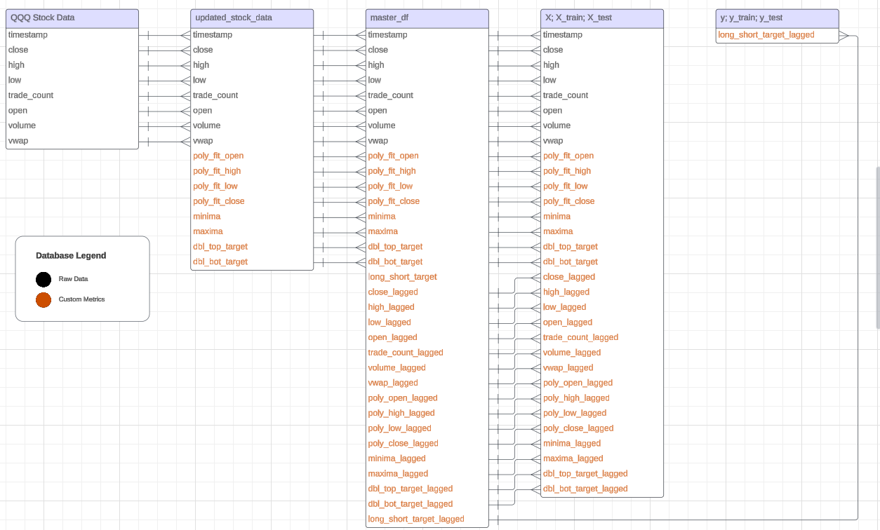
DATA MAP

Slide 8
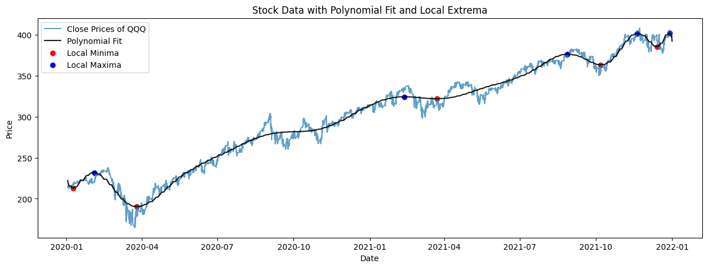
EDA - OUR PROCESS:
A Day Trader’s Dream
Automatic signals that could identify highly probable and profitable trades
Polynomial Smoothing:
Polynomial fitting involves using a polynomial equation to approximate a relationship between variables. In our stock data scenario, the polynomial smoothing process was implemented to model and understand the relationship between the stock's historical prices and time.
Extrapolating Local Minima & Maxima:
Daily 5 minute OCHL stock data is to be smoothed via a polynomial fit line in order to easily identify local minima/maxima and Numpy features utilized to establish. Closed polynomial fit data will be used to identify the local minima/maxima as standard day trading practice uses candle close data

Slide 9
Our Models
02
Support Vector Classifier, Logistic Regression, Polynomial Regression

Slide 10
SUPPORT VECTOR CLASSIFIER
A Support Vector Machine (SVM) is a machine learning algorithm used for classification and regression tasks. It is known for its effectiveness in finding decision boundaries that separate different classes or predict numerical values.
Final Model:
Accuracy: 0.8326731613317632
Precision: 0.0
F1: 0.0
Recall: 0.0
Reasoning behind scores: the most significant factor contributing to this is most likely a class imbalance in the data. With an SVM, especially with a linear kernel, it is very sensitive to imbalance datasets. In such cases, classifiers tend to be biased towards the majority class and may perform poorly on the minority class because they prioritize overall accuracy.

Slide 11
Logistic Regression
Logistic regression is a fundamental statistical and machine learning model used for predicting a continuous target variable based on one or more input features. It assumes a linear relationship between the inputs and the target variable, which means that the relationship can be represented by a straight line in a scatterplot.
Using GridSearchCV, we ran multiple Logistic Regression models using ‘linlinear’, ‘saga’, and ‘lbfgs’ solver algorithms with various regularization parameters ( C ), with values of 0.1,1.0 and 10.0.
Optimized Final Model = LogisticRegression (C = 10.0, solver = ‘saga’)
Accuracy: 0.8333333333333334
Precision: 0.8104575163398693 Confusion Matrix:
Recall: 0.8551724137931035 [[126 29]
F1 Score: 0.8322147651006712 [ 21 124]]

Slide 12
Polynomial Regression
A form of regression analysis where the relationship between our independent (X_train, X_test) and dependent variables (y_train, y_test) are modelled as nth degree polynomials in x. Though the polynomial regression fits a nonlinear model to the data, it is statistically a linear problem. This is addressed through fitting linearly to every x at the corresponding y.
Testing through various model parameter combinations and with only a 2nd degree polynomial to avoid overfitting.
Accuracy: 99.69% → Important, but feels as if the model may be over fitting
Precision: 87.65% → Identifies target class fairly well. This feels in line and not over fitting
Recall: 47.65% → Potential high number of false negatives.
F1 Score: 61.74% → Approaching the 70% score that is considered “good”.

Slide 13
CONCLUSIONS + OUR FINAL MODEL
03

Slide 14
Benchmark Model: SVM Model
Confusion Matrix
True Positive
False Positive
False Negative
True Negative
15,556
0
3126
0

Slide 15
Champion Model: Logistic Regression
Confusion Matrix
True Positive
False Positive
False Negative
True Negative
126
29
21
124

Slide 16
Experiment Conditions
5 minute stock market data
Post COVID Crash stock market
2 years of data (2020-01-01 through 2022-01-01)
Reviewed only QQQ security (reflects Nasdaq majority tech companies)
Target audience: day traders
Notes:
Why tech companies? Because of high volatility and more entries

Slide 17
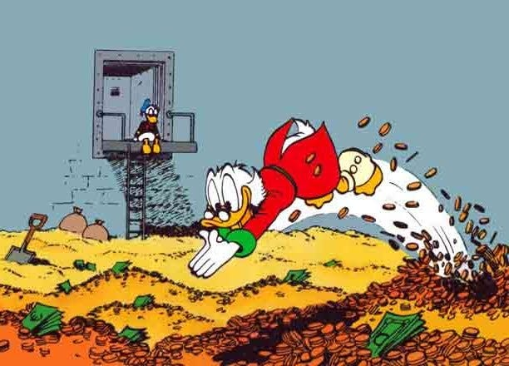
What’s Next?
Who would use this? And how?
Do we keep only to one security?
Do we automate more to buy and sell on its own?
Do we want to review more data?
Different time frames?
Verify via paper account trading?
Identify other patterns?

Slide 18
THANKS
Q & A!

